Slide 1




Computer vision classification – Malarial Cell Case Study
Turning a Kaggle example into a clinical decision-making tool
Gary Hutson
Head of Advanced Analytics
Arden & Gem CSU

Slide 2


A little about me…
Public Sector Data Scientist, Statistician, Deep and Machine Learner and interested in all things R and Python
Background in the criminal justice, council, police and national health service – find out more: https://hutsons-hacks.info/about-me
Coding in R for 7 years, or so, Python for about 3 years.
NHS-R Community Fellow and blogger: https://nhsrcommunity.com/
Ex Senior Data Scientist and Head of Data Science for Draper and Dash. Aided in creating the Data Science Platform, amongst lots more projects
Currently work for Arden & Greater East Midlands Commissioning Support Unit (CSU) working with CCGs and NHS England.

Slide 3
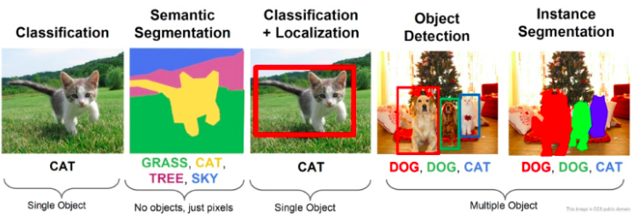
WHAT is computer vision?

Slide 4
Applicability to Healthcare
Aiding clinicians with the identification of problems faster e.g. at Mount Sinai hospital this is being used to detect neurological acute illnesses. This has been aided by utilising 40,000 CT scans from across the health system. This required a “joined up” approach
More precise diagnosis – CV algorithms can be trained on a massive amount of data that can detect the slightest presence of a condition. A human doctor might easily miss out on, as the algorithm could be trained to detect small anomalies that could be missed. Used alongside clinician skill, this could minimize false positives and improve diagnostic outcomes
Medical imaging – increases in CV applications have already been an assistance to clinicians and could be used to create binary and multiclass algorithms to check and detect certain conditions

Slide 5



R and Computer vision

Slide 6
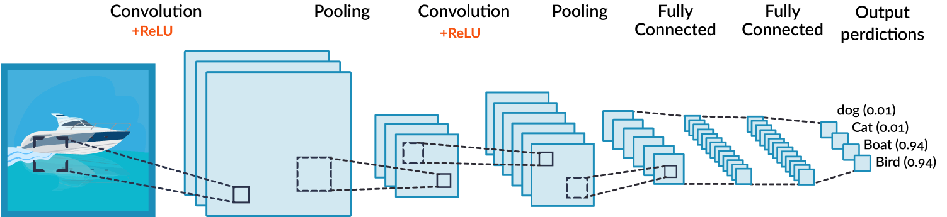
The powerhouse of cv – Convolutional neural networks

Slide 7
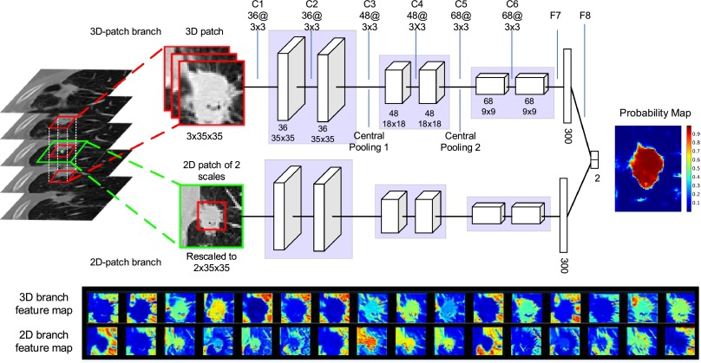
The powerhouse of cv – Convolutional neural networks

Slide 8

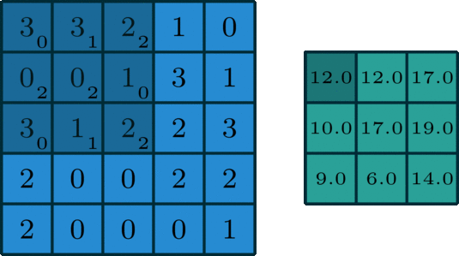
Graphical version

Slide 9
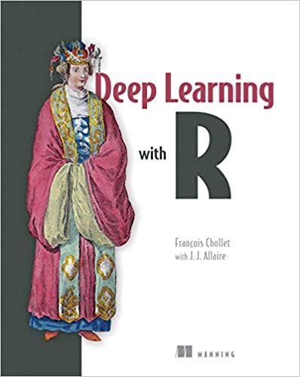
Check this book out

Slide 10

Building a cnn in r
The article published on my website shows the process of using a Kaggle malaria cell dataset to build a CNN in R for a binary classification task of whether someone’s cells have been infected with Malaria or not.
This type of model could be extended to work with multiple types of x-rays, cancer scans and other types of imaging procedures
The next few slides will show the process of building the model and the considerations I put in place

Slide 11
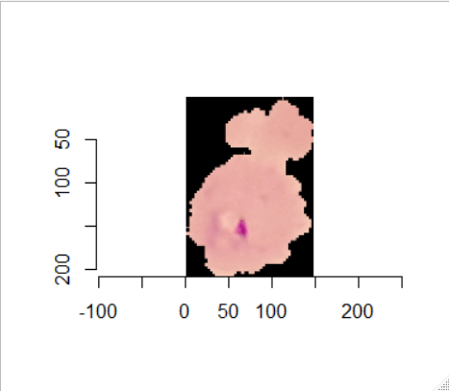
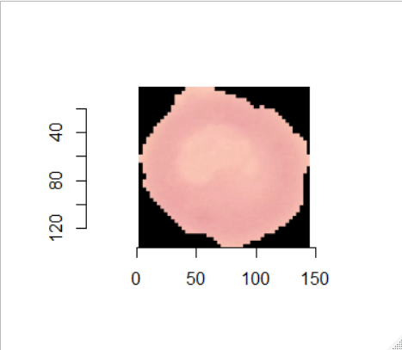
Examine the images and build the keras structure
The images need to be stored in a specific way to allow them to flow from a directory. My website gives a full example of the step by step process, and shows the resources used to build the R model in Keras and Tensorflow.
R functions have been created in the Github to process these images view the show_image() routine
Malaria Parasite Infection
Uninfected

Slide 12
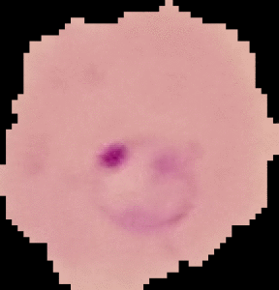
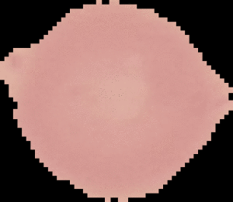
Examine the images and build the keras structure
Inspecting the dimensions of the images was the next step. Here all the images were of a different scale, so needed to be rescaled in Keras.
Next, I created an animation of the cells seen in the past two slides to check how the first 100 images differed from the 24,000 + images, albeit still a small sample for a CV project.
Malaria Parasite Infection
Uninfected

Slide 13
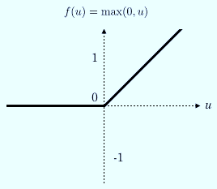
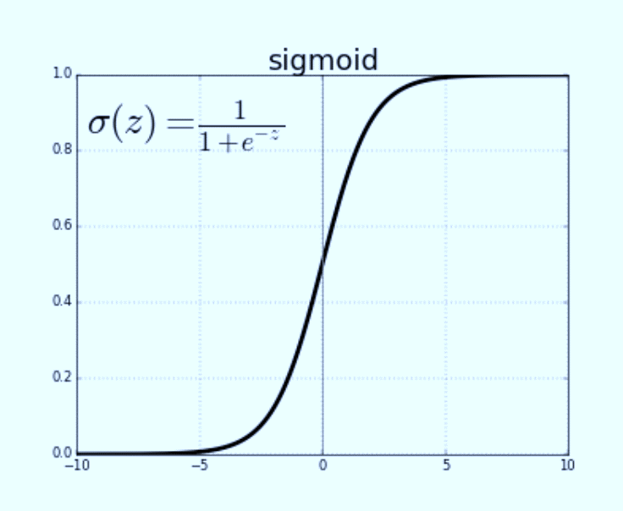
Activation functions used
Notes:
The rectified linear activation function or ReLU for short is a piecewise linear function that will output the input directly if it is positive, otherwise, it will output zero. It has become the default activation function for many types of neural networks because a model that uses it is easier to train and often achieves better performance.
An important benefit of the rectifier function is that it is capable of outputting a true zero value.
This is unlike the tanh and sigmoid activation functions that learn to approximate a zero output, e.g. a value very close to zero, but not a true zero value.
This means that negative inputs can output true zero values allowing the activation of hidden layers in neural networks to contain one or more true zero values. This is called a sparse representation and is a desirable property in representational learning as it can accelerate learning and simplify the model.

Slide 14
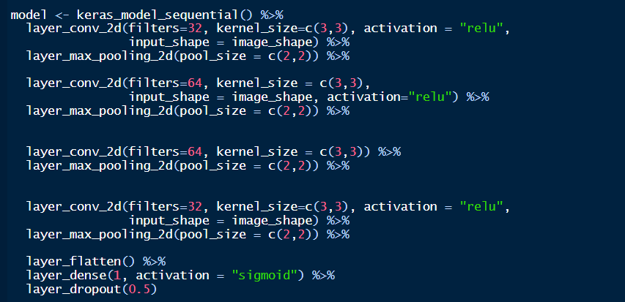
Building a baseline model
Convolution layer
Pooling Layer
Dense layer
Flattening layer
Dropout layer

Slide 15
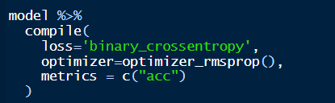
Compile model
Loss function
Optimizer to minimise loss

Slide 16
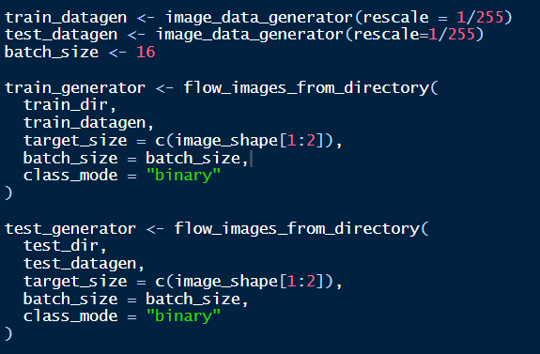
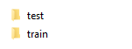
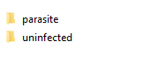
Flow images from directory

Slide 17
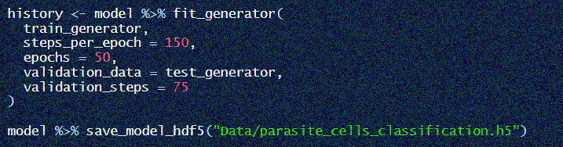
Fit the model

Slide 18
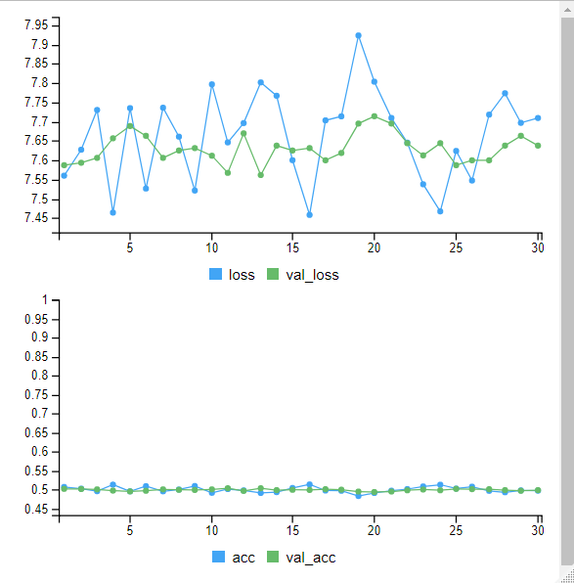
Keras plot

Slide 19
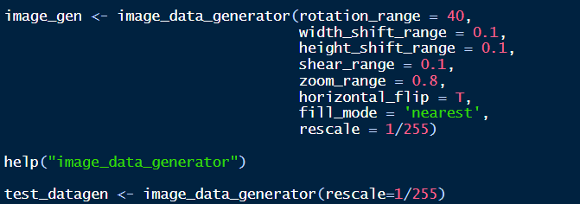
Data augmentation to improve model

Slide 20
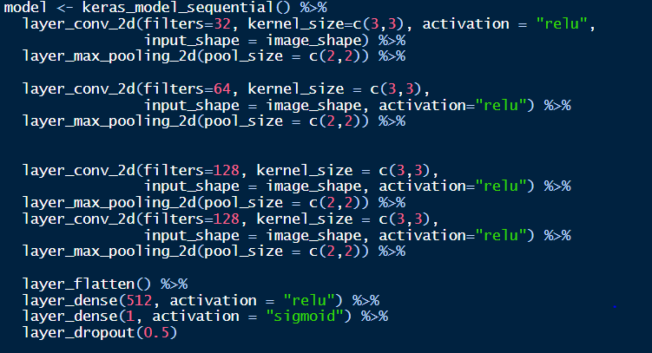
Reformat model structure

Slide 21
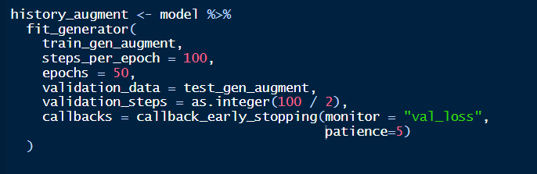
Fit augmented model
Callbacks were utilized to montor the value loss in the model, as this is the first sign that the model is starting to overfit. Early stopping allows for the model to terminate when it starts to overfit
Model generated from the augmented images – the main addition was the zoom in the previous slide. This allowed for the parasites to be viewed more clearly and thus improved the model performance

Slide 22

Wait…wait…wait…

Slide 23
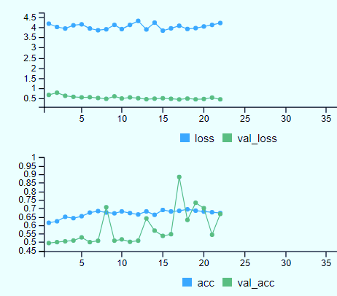
Analyse augmented model results

Slide 24
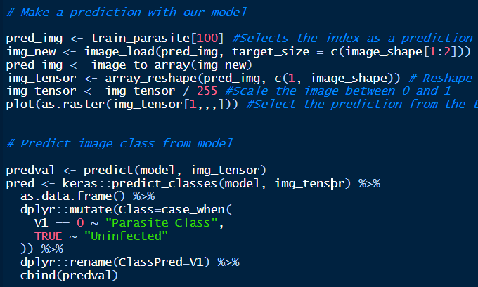
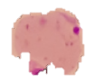
Predicting with our model
New sample
Class Pred Class Class Probability
0 Parasite Class 0.0010% (99% confident)

Slide 25
Further model improvements
There are not any pretrained networks available for this problem, making it different from a lot of the classification tasks. This needs to serve as a “call to arms” to an NHS imaging repository for various scans to improve the model trainability and to rival the ImageNet popular pretrained network – containing millions of images
Different model architectures and layering, such as the Inception network, RESNET, MobileNet, ResNet50, VGG16 and 19. Transformer networks are the new trend in NLP and are being applied to CV as we speak – watch this space: https://openreview.net/forum?id=YicbFdNTTy.
Image adjustments, scaling, etc. may allow the convolutional nets to detect the images more clearly, as shown with the adjustment of the zoom.

Slide 26
CV – THE R VS PYTHON STRUGGLE
With the addition of Tensorflow to R – this can easily handle classification tasks, utilising the Convolutional Neural Network architecture, but it does not have the packages to support advanced:
Object detection – Open CV works much better in Python and can be integrated to the Raspberry Pi (example on next slide)
Facial recognition, again Python wins on this front, as R’s VideoPlayR has only some of what Python has at its disposal. Example to follow shortly
Video streaming and capture can be done on both platforms but is still more fluid in Python – sorry!

Slide 27

NHS-R Reticulate session

Slide 28
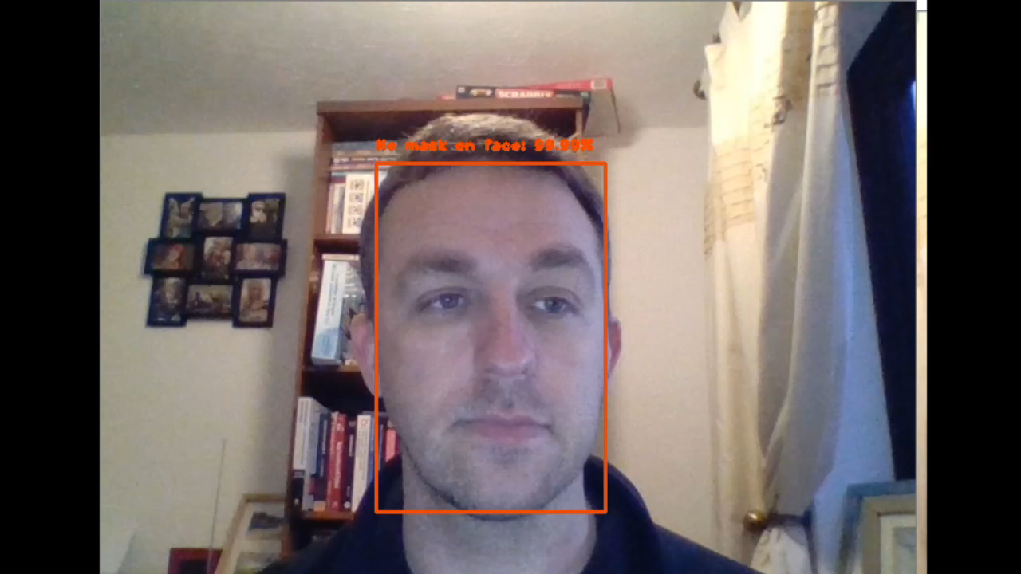
FACE MASK DETECTOR
Credit to PyImageSearch for original concept

Slide 29
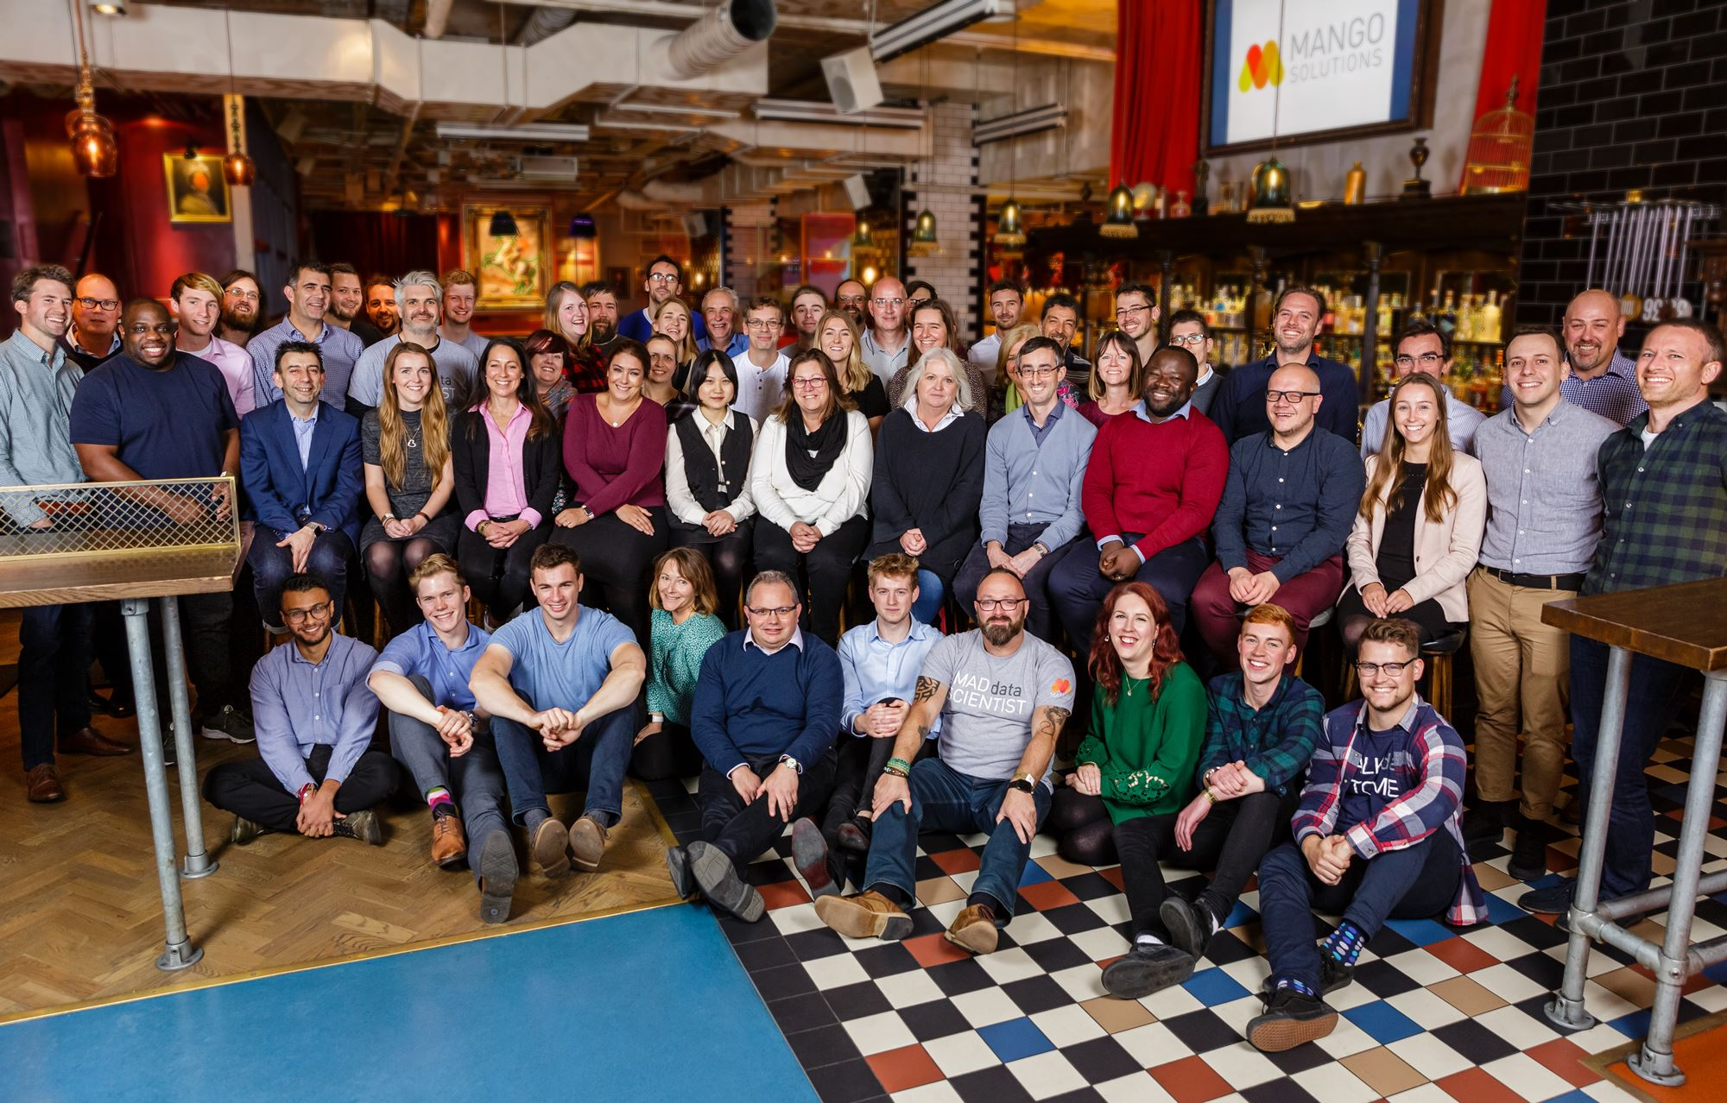

Slide 30
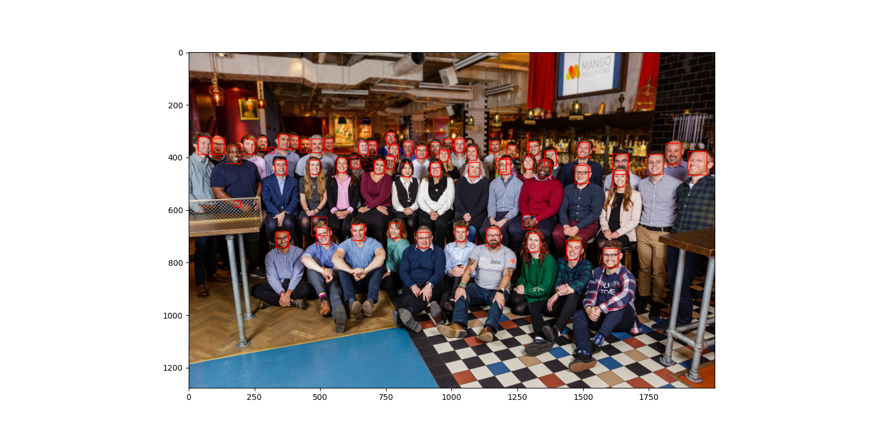
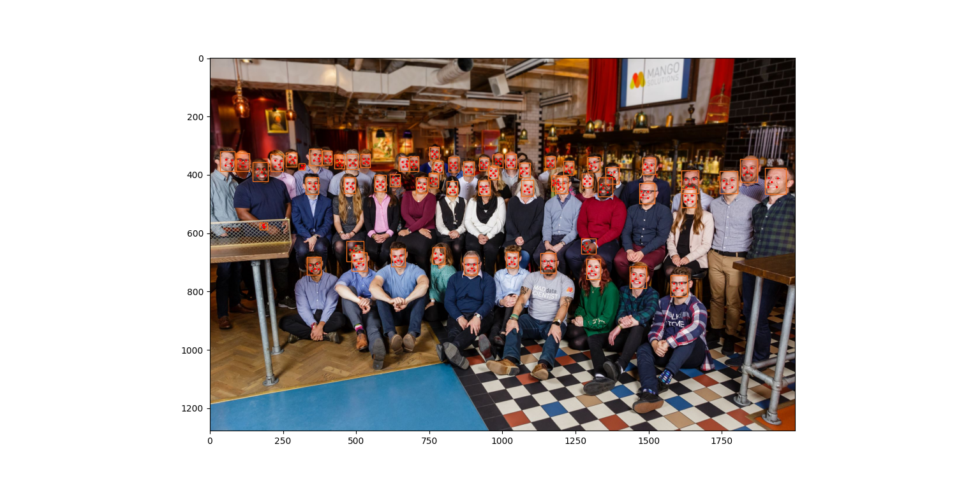
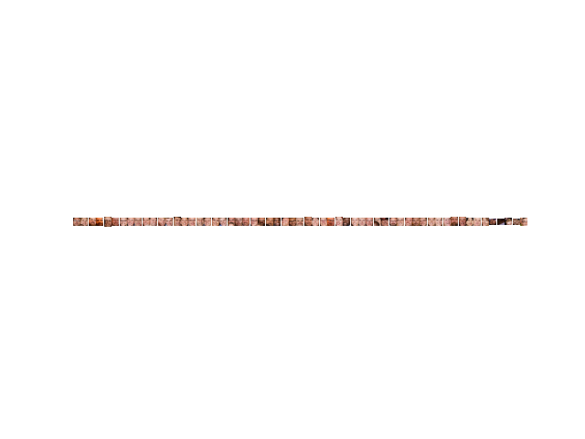

Slide 31

Questions?

